Slide 1



Slide 2
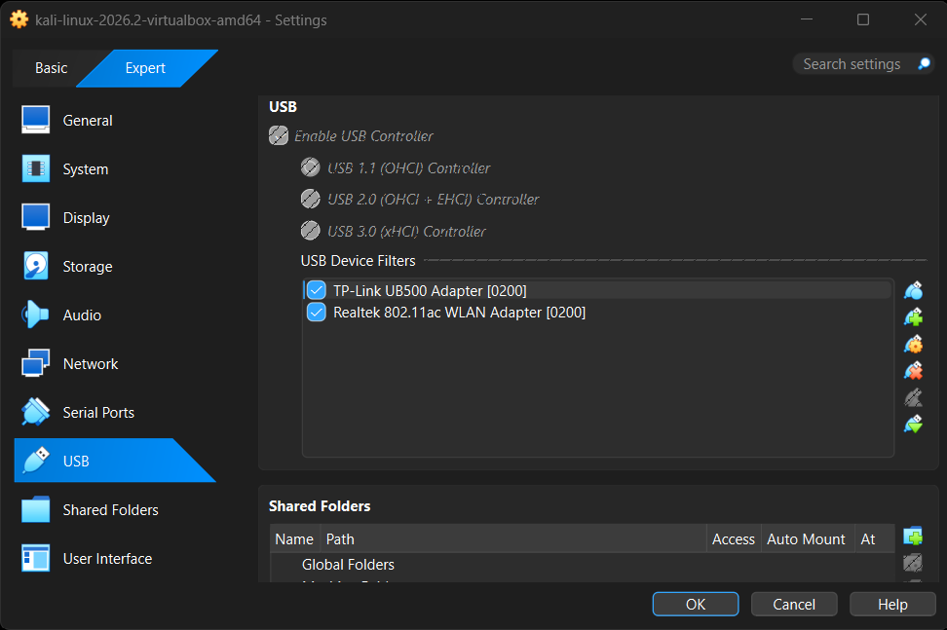
1. Getting Started
Bluetooth Security Hands-on Exercises
Log into your virtual machine and connect your Bluetooth adapter!
This is not necessary for Kali Linux installed directly on your laptop.
To begin the hands-on portion of this training, we’ll start with connecting to our training platforms and configuring our Bluetooth adapter.
From the Virtual Machine goto Devices/USB, Add TP-Link UB500 Adapter

Slide 3
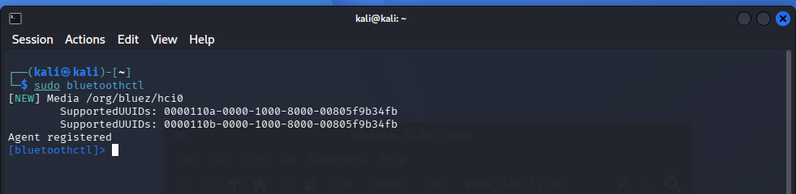
1. Getting Started
Bluetooth Security Hands-on Exercises
We’ll start off by making sure our BT adapter is on and running a page scan and an inquiry scan to see nearby devices.
https://linuxvox.com/blog/kali-linux-bluetooth/ has a good mini-tutorial.

Slide 4
2. Bluetooth Scanning
A good first step for any type of security assessment is searching for nearby devices
We know that we have a target device in our area. The first thing we have to do is find that device.
On Windows you can download and run BT Scanner from the Microsoft Store. There are a few Bluetooth scanning apps available for Android (BLE Scanner, Bluetooth Scan) and iPhone!
USB
VM
Scanning for BT devices in our proximity will let us find the target device and it’s BT address

Slide 5
2. Bluetooth Scanning
Scanning for BT devices will show you devices in your area that are discoverable
Modern devices are usually non-discoverable by default, unless you are connecting/pairing with a new device
USB
Our device has intentionally been put into
discoverable mode for this training
VM

Slide 6
2. Bluetooth Scanning
You should be able to detect the target device (and some of your fellow students)
USB
Be sure to note the target device’s BT address!
You’ll be using it a lot
VM

Slide 7
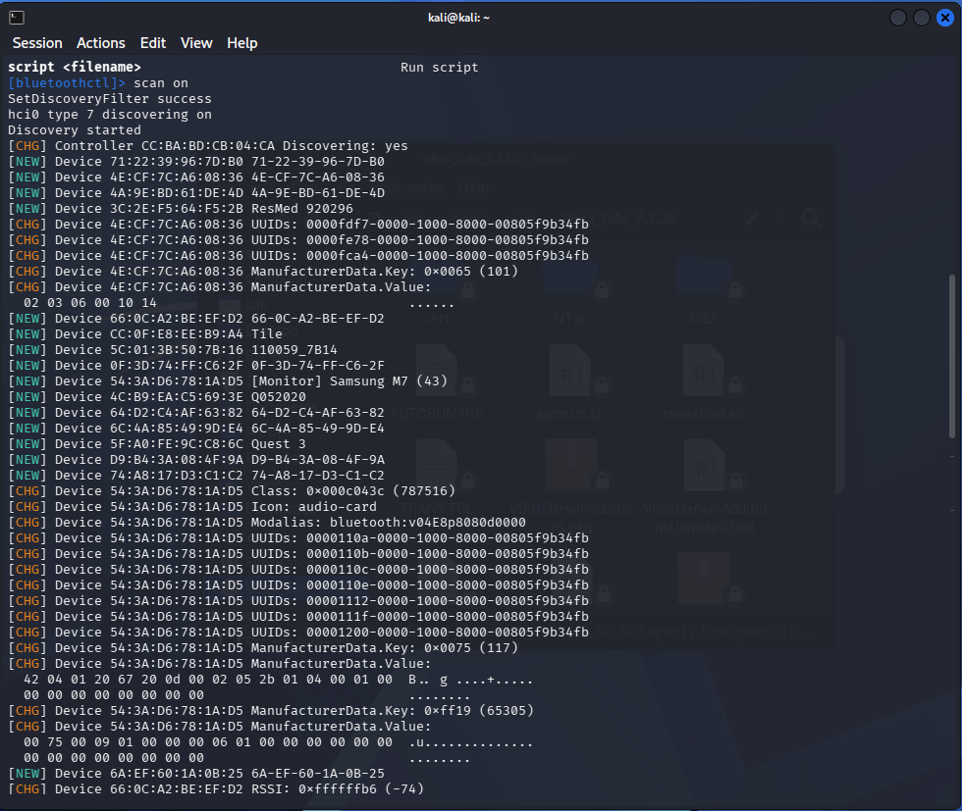

Slide 8
A Note on BT Addresses and Scanning
Bluetooth Address
48-bit “unique” value
AA:BB:CC:DD:EE:FF
First 3 Bytes: Organizationally Unique Identifier (OUI)
  First 2: Non-significant. address Part
  Third: Upper Address Part
Last 3 Bytes: Lower Address Part
Normally invisible unless discoverable
*OUI =/= Chip manufacturer!

Slide 9
3. Enumerating Bluetooth Information
Now we’ve found the BT address of the target device. This is how we’ll address our information requests to it
We want to learn as much as possible about our target over Bluetooth
Keep in mind, all of this information is obtained before any pairing or authentication with the target
We just need to know its BT address
INFO?

Slide 10
4. Identifying BT Services
BT is used for lots of different applications. What applications an individual BT device is configured to support can be discovered using the Service Discovery Protocol
SDP is a special BT protocol – it’s meant to let devices learn about how they can interact with one another
SDP
As a result, SDP information is often shared without encryption or authentication
SERVICES

Slide 11
4. Identifying BT Services
When you want to learn what BT services are in use by a target device, checking its SDP server is a good first step
It can be seen as a “port scan” of a BT device
SDP
SERVICES

Slide 12
5. Analyzing SDP Output
Depending on how complex the target is, the
SDP server may give you a lot of data
We’ve added a special service to this device for
the purpose of this training
SDP
This service will be a target for you to send data to and perform other tests
SERVICES

Slide 13
5. Analyzing SDP Output
Analyze the data you received from the SDP server
You’ll need to know the RFCOMM channel in use by the custom service to be able to send data to it
SDP
There’s also a few hints in the SDP data of the custom service that you may want to keep track of
SERVICES
Proceed through part 6 of your Lab Manual

Slide 14
6. Pairing Devices In Linux
We’ve found the target service hosted on the device, and now we want to get started interacting with it
The target service is designed not to interact with other devices unless it is paired with that device, however
We’ll use the hints we found in previous steps and the tools available in Linux to pair with the target device

Slide 15
6. Pairing Devices In Linux
There are two general forms of pairing – Legacy Pairing and Secure Simple Pairing (SSP)
SSP is the more secure version by far, but our target is configured to use legacy pairing for this training
Older devices that only supported legacy pairing would use a PIN code to pair. On some devices, this was a manufacturer-set default code like 0000 or 1234

Slide 16
6. Pairing Devices In Linux
Once we’ve paired to the target device we can
send data to the target service
You can attempt to send data without pairing, but it wont’ be accepted! Pairing and connecting with devices are two separate concepts
Follow your Lab Manual through step 7 to complete the pairing process.
This might need a few attempts with so many people pairing at once*

Slide 17
7. Sending Data Over Bluetooth
Now that we’ve paired with the target device, it’s time to finish up the CTF
We’ve set up the target service to accept text data sent over BT to the target service’s RFCOMM channel
Key 1
There are two flags to find:
The first one is hidden in the information you can see
with the tools you’ve learned
The second will be revealed when you successfully send the first key to the target service
Key 2

Slide 18
7. Sending Data Over Bluetooth
Sending data over BT is not very hard, but we’ve developed a custom helper script for you to make it easier
Find the first key hidden in the data you can read – following the clues we left
Key 1
Key 2
Once you’ve found it, follow the steps in your Lab Manual to use the helper script and find the second key!

Slide 19
Bluetooth Tools
Tools
  Hardware
    Laptops with built-in Bluetooth
      Most support BLE
    USB Dongles, with antennas
      Linksys USB-BT100 modified
      Sena UD100, supports BLE too
    BLE Specific
      Adafruit BLUE Sniffer (NRF 51822) $25 works with Wireshark
      TI CC2540EMK + SMARTRF Tool (proprietary) $40
  Commercial
    http://www.fte.com/products/sodera.aspx
    https://www.ellisys.com/products/bex400/
    Typically doesn’t have security vulnerability checking functionality

Slide 20
Bluetooth Tools
Software
  Linux
    Kali Linux: https://linuxvox.com/blog/kali-linux-bluetooth/
    BlueZ: hctitool, gatttool, bluetoothctl
    BTScanner, BLE Sniffer, btmon
    BLESuite: BLE-Replay
    BLE Fuzzing, BlueHydra
    Crackle (PIN cracking)
    Ubertooth One
      Good for sniffing, but not as actual BT device (doesn’t channel hop)
      Help find non-discoverable devices
      http://www.greatscottgadgets.com/ubertoothone/
      https://hakshop.com/products/ubertooth-one
      https://github.com/greatscottgadgets/ubertooth

Slide 21
Bluetooth (BT) Information
Basics
  Short range Wirelesss Personal Area Network (WPAN)
  Based on IEEE 802.15.1 Standard derived from Bluetooth SIG
  Named after Viking King Harald Bluetooth
  Co-exists with WiFi and cordless phones on 2.4Ghz band
  Applications include Headsets, keyboards, mice, serial links, networking, …
  Ad-hoc network not under any form of centralized control, pairing is called a piconet
  Driven more by marketing than engineering, low cost
  Wireless technology from 2.4 to 2.485 Ghz with 2.1 Mbps Enhanced Data Rate (EDR)
  Up to 10m, but potentially up to 100m (BT 5 potential to 400m) on 79 channels
  Power classes:
    100m (100mW)
    10M (2.5mW) - typical
    1M (1mW)
  Many versions (1.0, 1.1, 1.2, 2.0, 2.1, 3.0, 4.0 (LE), 4.1, 4.2, 5, 6, …)
  Complicated protocols leading to vulnerabilities in poor implementations
    Specification is 4x more complicated than for WiFi
  Frequency Hopping Spread Spectrum (FHSS) + Adaptive Frequency Hopping (AFH)
    Channel hopping invented by Hedy Lamarr
    Interference resistant
  BT 3.0 adds Alternate MAC and Phy (AMP) for 802.11 data transfer
Links
  Bluetooth Special Interest Group (SIG) https://www.bluetooth.com/
  https://en.wikipedia.org/wiki/Bluetooth
  https://en.wikipedia.org/wiki/List_of_Bluetooth_protocols

Slide 22
Bluetooth (BT) Information
Bluetooth Low Energy (BLE)
  Redesigned physical layer
  Faster network connection and termination
  Allows radio power down to save battery
  Short bursty data transfer applications up to 1Mbps
Bluetooth Protocol Stack (top to bottom)
  --- Host Software: ---
  PPP, IP Stack, Applications
  Bluetooth Profiles (RFCOMM, BNEP, OBEX) – Functions
    Radio Frequency Communications (RFCOMM)
    Bluetooth Network Encapsulation Protocol (BNEP)
    Object Exchange Protocol (OBEX)
    Headset audio
    Dial-up Networking
  Logical Link Control and Adaptation Protocol (L2CAP) – abstraction, packet fragmentation, reassembly, QoS function
  --- Interface: ---
  Host Controller Interface (HCI) – Layer between host and device (driver)
  --- Device Hardware/Firmware: ---
  Link Management Protocol (LMP) – Discovery, enumeration, setup, teardown
  Baseband Controller, Framing – Packet assembly, disassembly
  Radio Interface, RF Controller – Radio interface, channel changing, synchronization, modulation, demodulation

Slide 23
Bluetooth Security
Basics
  Security starts with 2.1 using SAFER+ block cipher using PIN and MAC
  Most devices use a static PIN such as 0000 or 1234
  Weak authentication
  Possible to identify non-discoverable devices and attack
  Older devices are less secure
  Long history of security concerns
Security Modes
  Node never initiates any security
  No link encryption, application-level security options
  Link encryption before any data is exchanged
Security Mode 3
  PIN mixed with MAC to generate 128 bit key
  SAFER+ cipher used to hash content for authentication
  Link key generated for subsequent authentication
  EO Cipher, similar to RC4, Stream XOR’d with plaintext to create ciphertext
  Uses Linear Shift Feedback Registers (LSFRs) for hardware adaptation
Security Tips
  Best security is to turn off Bluetooth when not in use
  Disable unneeded profiles
  Make non-discoverable
  Update software

Slide 24
Bluetooth Vulnerabilities
Attacks
  Classic Pairing Authentication (BTCrack v1.1)
    Guess PIN and key offline
  Classic PIN Cracking
    Capture initial pairing exchange
    Impersonate master or slave
    Transmit “not accepted”
    User is prompted to re-enter PIN
  BT MAC (BT_ADDR) might be one off from WiFi MAC
Known Exploits/Vulnerabilities
  BlueBorne https://www.armis.com/blueborne/
  Bluejacking https://en.wikipedia.org/wiki/Bluejacking
  Bluesnarfing https://en.wikipedia.org/wiki/Bluesnarfing
  General: http://airodump.net/bluetooth-security-vulnerabilities/
  DirtyTooth
    http://www.dirtytooth.com/
    https://www.elevenpaths.com/labstools/dirtytooth-para-raspberry-pi-2/index.html
CERT CVE Lookup
  http://cve.mitre.org/cgi-bin/cvekey.cgi?keyword=bluetooth
NIST Guidelines
  https://csrc.nist.gov/csrc/media/publications/sp/800-121/rev-2/draft/documents/sp800_121_r2_draft.pdf
SANS Whitepaper
  https://www.sans.org/reading-room/whitepapers/wireless/bluetooth-inherent-security-issues-945

Slide 25
Bluetooth Low Energy (BLE) Information
Bluetooth Low Energy (BLE)
  Classic BT became overly complicated
  Needed less overhead
  More competitive with ZigBee
  Redesigned physical layer
  Faster network connection and termination
  Allows radio power down to save battery
  Short bursty data transfer applications up to 1Mbps
Changes from Classic BT
  AMP just hands off to standard WiFi
  Gaussian Frequency Shift Keying (GFSK) instead of FHSS
  Separate radio, same antenna
  40 channels, next hop is mod 37
  BLE leverages GATT/ATT protocol for data exchanges, replaces RFCOMM
  Standardized protocol for all profiles to reduce overhead

Slide 26
Bluetooth Low Energy (BLE) Security
Security
  Pairing similar to Classic Bluetooth
  Keys are not retained, renegotiated each time
  Bonding retains keys
  LE 4.2 is most secure using Out of Band (OOB) pairing
Vulnerabilities
  “Just Works” mode is not secure (TK=0)
  Profiles are similar to Classic Mode 1
  Easy to find advertising devices, track and capture
  PIN cracking is easier if pairing exchange is captured
  Currently no way to force deauthorization
  Security left up to applications
  GATTacker is a Man-In-The-Middle (MITM) tool which spoofs both master and slave

